Slide 1
Market Basket Analysis For
Revenue & Customer Retention Optimization
Presented By : Manndeep Patel and Satyam Sharma
Project Team ID : PTID-CDA-JAN-26-1165
Project ID: CDACL005

Slide 2
Tools Used in Project
OBJECIVE
SQL
(To Extract the data from database)
Power BI
(To clean the data and used for Visualization)
Python
(Used to perform Apriori Algorithm)
Statement :
The objective is to identify product combinations and customer behavior patterns to drive revenue growth.

Slide 3

Business Objective
Objective of the Project :
Perform market Basket Analysis using Apriori.
Identify Frequent item sets and association rules.
Visualize purchase behavior patterns
Derive actionable bundling recommendations.

Slide 4



Dataset
Overview
22K+ Transactions across 4298 customers.
Revenue of 10.28M generated within analysis period.
Transactional Level retail dataset including returns & free Items.
Interpretation:
The Dataset provides sufficient scale and transaction depth to reliably model purchasing behavior and cross-sell opportunities.

Slide 5
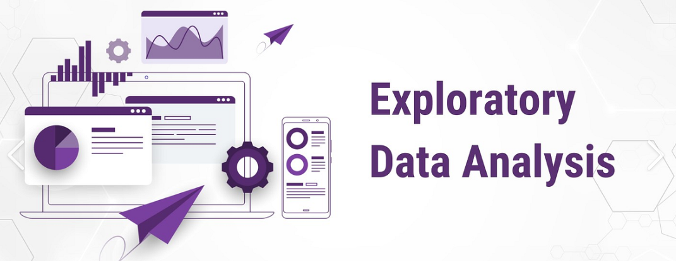
Exploratory Data Analysis (EDA) Summary
Analyzed distribution of Quantity and Price:
• Identified outliers and return patterns
• Examined revenue trends across time and geography
• Evaluated basket size distribution
EDA findings informed data cleaning decisions and guided subsequent Market Basket Analysis.

Slide 6

Data Cleaning & Preparation
Data Issues Identified:
• Missing Customer ID
• Duplicate invoices
• Blank / inconsistent item names
• Non-positive prices
• Data type inconsistencies
Cleaning Actions Performed:
• Removed 5,287 exact duplicate rows
• Replaced missing Customer ID with “Anonymous Purchase”
• Standardized product names (Itemname_Clean)
• Preserved returns & promotions as valid business events
• Excluded non-positive prices from revenue measures
• Created Revenue column (Quantity × Price)
Impact:
Ensured accurate association rules and reliable business insights.

Slide 7


Data Transformation For
Market Basket Analysis
• Converted dataset into BillNo–Item transaction format
• Calculated Basket Size per transaction
• Grouped baskets into Small / Medium / Large
• Structured binary transaction matrix for Apriori
Impact:
Prepared dataset for reliable frequent itemset mining.

Slide 8

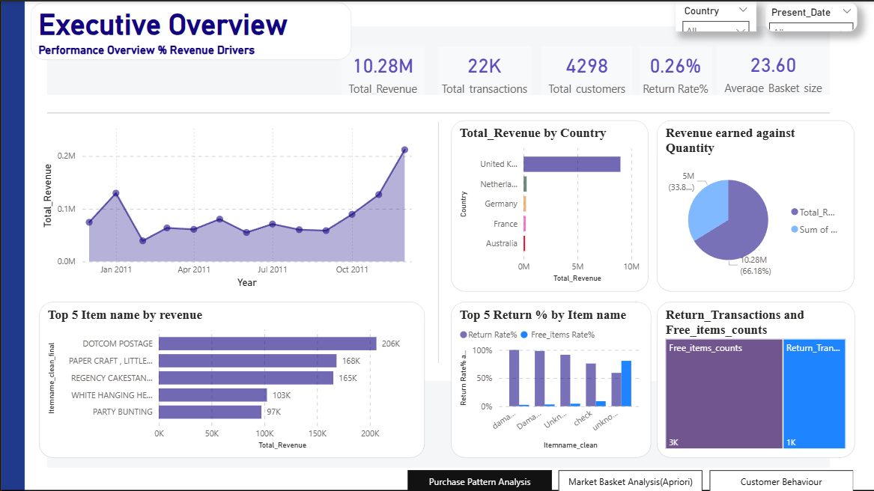
Revenue & Performance Overview

Slide 9
Revenue & Performance Insights
Key Business Insights:
Revenue reached 10.28M across 22K transactions.
Strong year-end growth trend
observed.
Return rate remains low at 0.26%, indicating stable product satisfaction.
Top 5 products contribute significantly to revenue concentration.
Business Interpretation:
Revenue growth is stable and seasonally driven.
Returns are negligible, indicating operational efficiency.
Revenue is concentrated in top-performing SKUs.
Cross-sell expansion opportunity exists.
Strategic Implication:
Focus inventory planning and promotional campaigns around year-end seasonal spikes and high-performing SKUs.

Slide 10
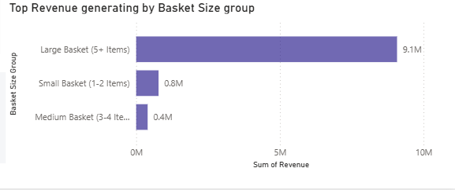
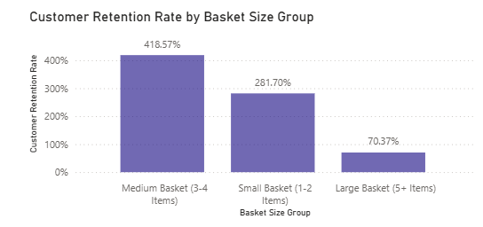
Basket Behavior Analysis
Insights:
• Large baskets generate higher revenue.
• Medium baskets show strongest retention correlation.
• Basket depth influences retention.
Business Interpretation:
Encouraging customers to shift from small to medium baskets presents a measurable and scalable revenue growth opportunity.

Slide 11
Key Metrics In Apriori Analysis
Support
Measures how frequently an item or itemset appears across all transactions—the foundation for identifying popular combinations
Support
Confidence
Confidence
Confidence
Lift
Calculates the probability that item B is purchased when item A is bought—revealing directional purchasing relationships
Lift
Quantifies association strength; lift > 1 indicates positive correlation, meaning items are bought together more often than by chance

Slide 12
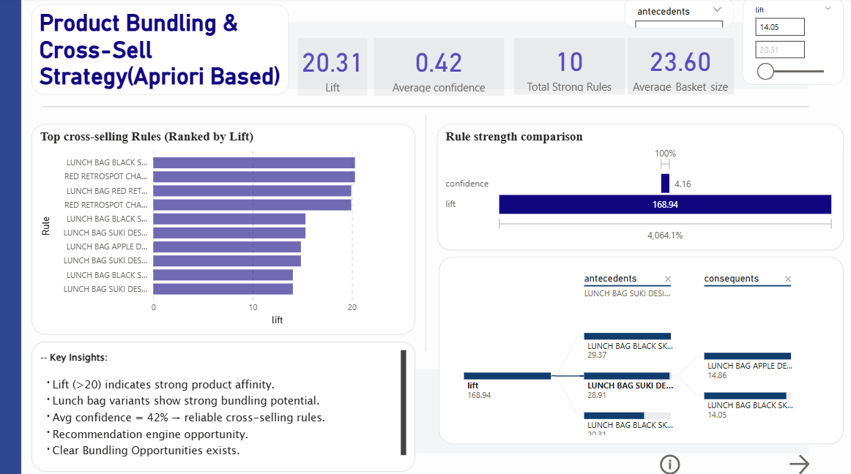
Product Bundling (Apriori)

Slide 13
Product Bundling (Apriori) Insights
Findings:
10 Strong association rules identified.
Max Lift : 20.31 (Very strong product affinity)
Average confidence: 42%
Lunch bag variance shows strong bundling potential.
Strategic Interpretation :
High lift values confirm predictable cross- selling behavior that can be operationalized through structured bundle pricing.
Statement:
Bundling high-affinity products
Presents an immediate, scalable revenue optimization opportunity.

Slide 14
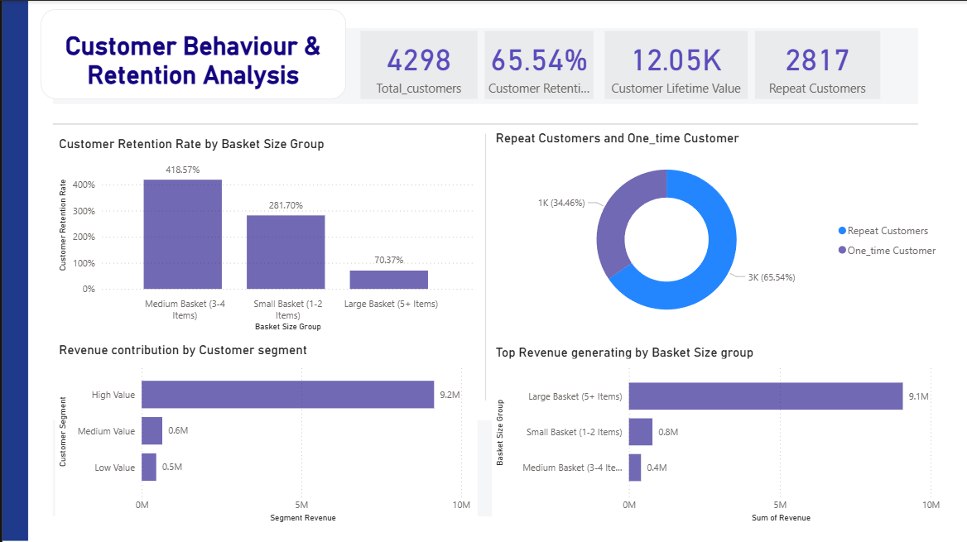
Customer Retention And Value Analysis

Slide 15
Customer Retention And Value Analysis
Findings:
Retention rate: 65.54%
Repeat customers: 2,817
CLV: 12.05K average
High-value segment drives majority
revenue.
Strategic Insights:
Revenue stability is primarily driven by repeat customers rather than one-time buyers.
Business Implication:
Retention-led growth strategy may yield higher ROI than aggressive acquisition expansion.

Slide 16


Integrated Growth Logic
Product Affinity:
→ Increased Basket Size
→ Higher Revenue Per Transaction
→ Stronger Retention
→ Increased Customer Lifetime Value
Strategic Statement:
→ Market Basket Analysis validates basket expansion as a sustainable and scalable growth engine.

Slide 17

Predictive & Strategic Outlook
Growth Scenario 1:
→ If average basket size increases by 5–10%:
Revenue per transaction increases proportionally.
Cross-sell conversion improves.
Growth Scenario 2:
→ If retention improves by 3–5%:
CLV increases significantly.
Revenue volatility reduces.
→ A data-driven bundling and retention strategy positions the business for scalable, low-risk revenue acceleration.

Slide 18
Final Recommendations
Launch targeted bundle campaigns based on high-lift Combinations.
Incentivize medium-basket growth through threshold offers.
Prioritize repeat-customer loyalty strategy.
Implement intelligent cross-sell recommendations at checkout.
Monitor Basket Size as a strategic KPI

Slide 19



MEET OUR
TEAM MEMBERS
Satyam Sharma
Manndeep Patel

Slide 20

THANK YOU
VISIT US

